Slide 1

Telangana Weather / Climate
Data Analysis On Power Bi

Slide 2
About me
Background:
Name: Patil Bharath Sai
University : Kalasalingam Academy of Research and Education, Virudhunagar, Tamil Nadu.
Education : B-tech, Computer and Science Engineering in Artificial Intelligence and Machine Learning.
Why I want to learn Data Science:
I am highly motivated to understand how data-driven insights can solve real-world problems
It has high demand profession and have many career path opportunities
Influencing decision-making and driving innovation
Work Experience: 4 Internship – 3 months Experience in 2 intern
DevTown – Data Science Intern
Bharat Intern – Machine Learning
My Company – Backend Developer
Forage – Accenture Data Analyst
LinkedIn : Patil-bharath-sai-b7065027a/
GitHub : https://github.com/PATIL-BHARATH-SAI

Slide 3
1. Business Problem & Use Case / Domain Understanding
What to include:
Domain: Telangana Weather / Climate Data Analysis.
Business Problem: Weather fluctuations impact agriculture, health, energy, transport. Understanding weather trends helps in policy making, disaster management, and planning.
Use Case Examples:
Agriculture → Crop yield prediction, irrigation planning.
Health → Heatwave/humidity-related illness tracking.
Infrastructure → Flood risk analysis, Transport.
Renewable Energy → Wind/solar forecasting

Slide 4
2. Objective of the Project
Key goals:
To analyze rainfall, temperature, humidity, wind across districts/mandals.
Identify extreme events, anomalies, seasonal & long-term trends.
Compare district-level weather patterns.
Provide actionable insights for agriculture, health, and government planning.

Slide 5
3. Data Importing– Details
Scraped data (Dataset source): Weather Data (Given)
Websites that can be used → IMD (Indian Meteorological Department), Climate Data Online, etc.
Process Followed:
Identify pages (daily/weekly weather reports).
Store into CSV/Excel.
Data Cleaning (remove nulls, fix formats).
Challenges Faced:
Inconsistent formats.
Missing data for some districts.
Handling dynamic websites (needed Selenium).

Slide 6
4. Summary of the Data
Columns: District, Mandal, Date, Rain (mm), Min Temp, Max Temp, Min Humidity, Max Humidity, Min Wind Speed, Max Wind Speed.
Size: Rows = 6,51,366; Columns = 9.
Date Range: 2010–2024.
Granularity: Daily records → aggregated to monthly/seasonal/yearly.
Issues: Missing values, outliers, inconsistent spellings (fixed during cleaning).

Slide 7
Exploratory Data Analysis:
Data Cleaning → Remove errors & prepare reliable dataset.
Data Manipulation → Create new features & restructure data.
Univariate Analysis → Study each variable individually.
Bivariate Analysis → Study relationships between two variables.

Slide 8
Data Cleaning Steps The goal is to make raw data usable and reliable.
Remove duplicates
Drop rows with same District + Date (or unique ID).
Drop duplicates : Remove Duplicates in Power BI/Excel.
Handle missing values (Nulls)
Rainfall → Replace null with 0.
Temperature, Humidity, Wind → Fill using interpolation/forward-fill or mean.
If too many nulls → drop column/rows.
Fix data types
Dates → Convert to Date format.
Numeric values → Convert to integer/float.
Categorical → Ensure text format.
Standardize column names
Example: Rain (mm) → Rain_mm.
Outlier detection & treatment
Use boxplots or IQR method.
Cap extreme values (Winsorization is a data transformation technique used to limit extreme values (outliers) in a dataset to reduce the effect of possible spurious outliers) or keep if meaningful.
Consistency check
Units (°C, mm, kmph).
Negative values in Rainfall, Temp, etc. → should not exist.

Slide 9
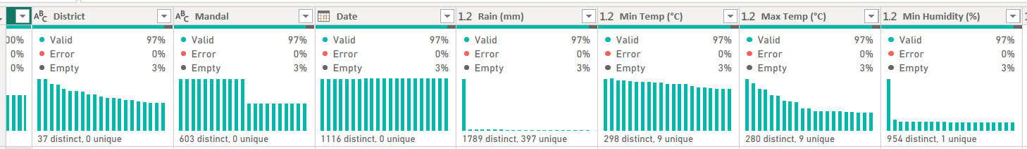
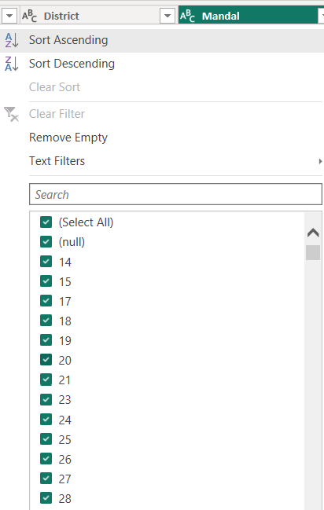
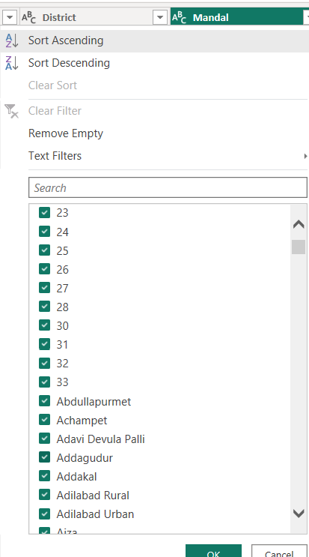
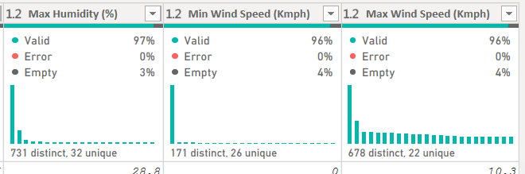
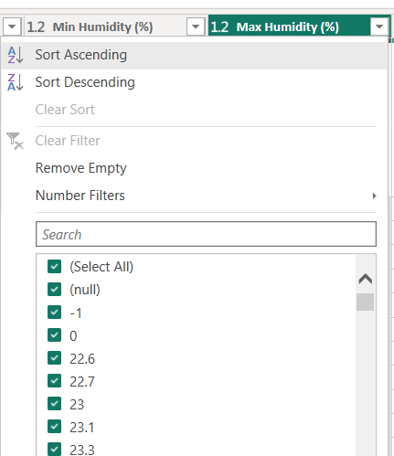

Slide 10
Data Manipulation Steps After cleaning, we transform & enrich data for analysis.
Feature Engineering
Create Temperature Range = Max Temp − Min Temp
Create Humidity Range = Max Humidity − Min Humidity
Create Wind Range = Max Wind Speed − Min Wind Speed
Time Features
Extract Year, Month, Quarter, Season from Date.
Useful for trend/seasonal analysis.
Aggregations
District-level monthly/annual averages.
Example: GroupBy District, Year → Avg Temp, Total Rainfall.
Normalization / Scaling Scale rainfall/temp values for fair comparison.
Encoding categorical variables
Convert District/Mandal into labels.
Joining with external datasets (if any)
E.g., population data, disaster data, crop yield data.

Slide 11
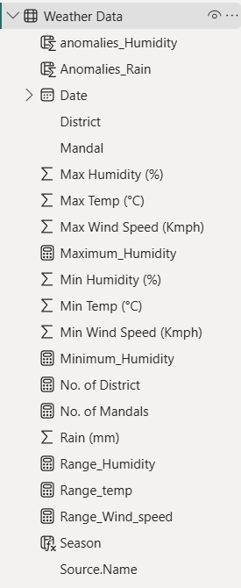
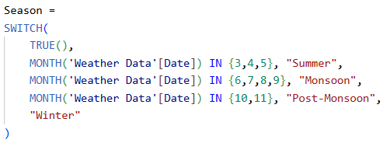

Slide 12
Univariate Analysis Steps
✅ Univariate = Analysing one variable at a time.
Helps understand distribution, central tendency, spread.
Categorical variables (District, Mandal)
Use Bar Charts → frequency/count.
Numerical variables (Rainfall, Temp, Humidity, Wind)
Histogram / Density Plot → distribution.
Scatter chart → outliers & spread.
KPI Cards → mean, min, max.
Summary statistics
Mean, Median, Mode.
Min, Max, Range.
Standard Deviation, Variance.

Slide 13
Bivariate Analysis Steps Analysing two variables together.
Helps find relationships & correlations.
Numerical vs Numerical
Scatter Plot → Rainfall vs Temperature.
Column chart → see relationships among Rain, Temp, Humidity, Wind.
Categorical vs Numerical
Waterfall chart→ Rainfall by District.
Clustered Bar Chart → Avg Temperature by District.
Time-Series Relationships
Line Chart → Rainfall trends over years.
Multiple Line Chart → compare districts.
Seasonal Comparison
Grouped Bar Chart → Quarterly Rainfall by District.
Extreme Events vs Districts
Compare number of anomaly days across districts.
🔍 Example:
High Rainfall days → correlated with High Humidity.
High Temp districts → lower Rainfall.

Slide 14
5. Key Business Questions
Which districts experience highest/lowest rainfall?
What are the seasonal patterns of weather metrics?
How do rainfall, temperature, humidity, and wind correlate?
Which districts face extreme weather events?
Are there year-over-year trends in rainfall and temperature?
Can anomalies (e.g., floods, droughts, heatwaves) be detected?
How do two districts compare in overall weather behavior?

Slide 15
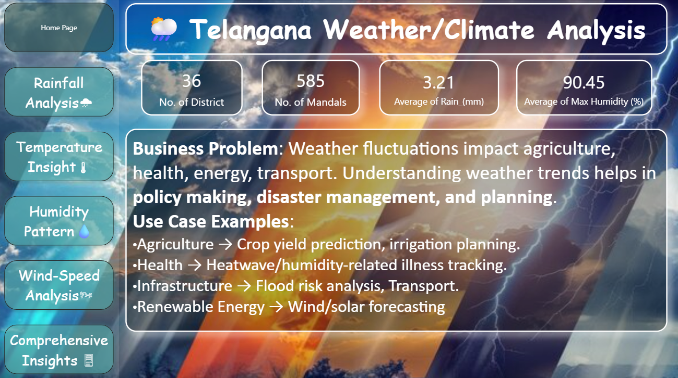

Slide 16
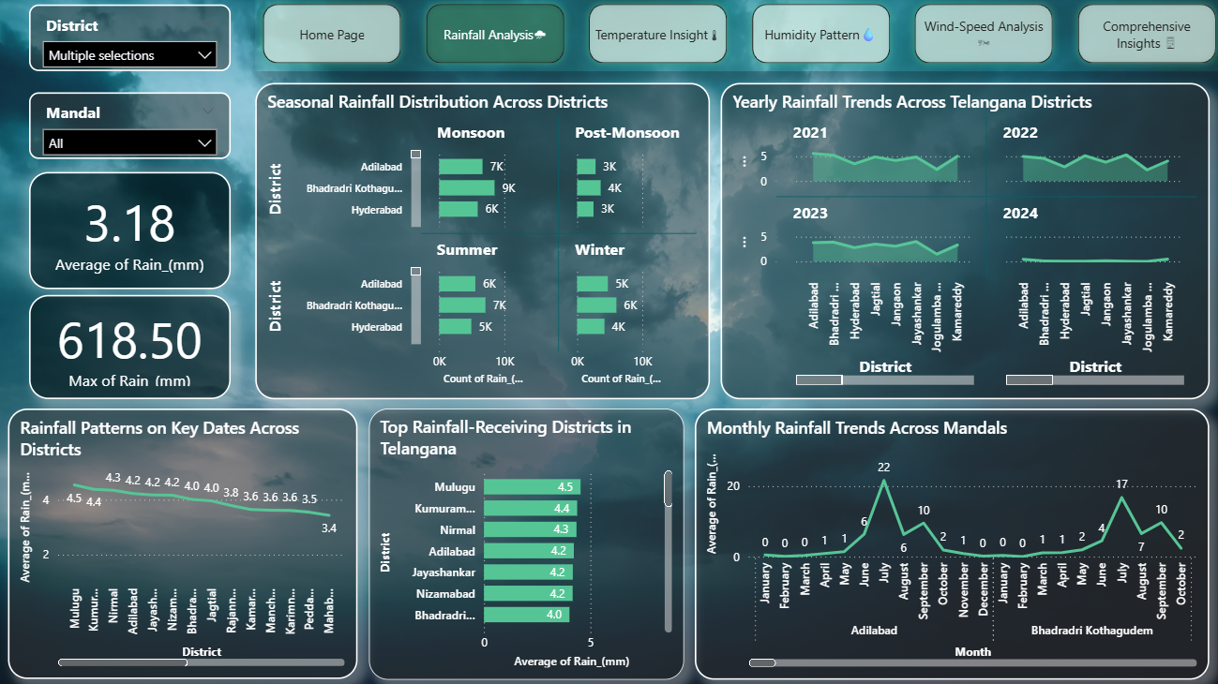

Slide 17
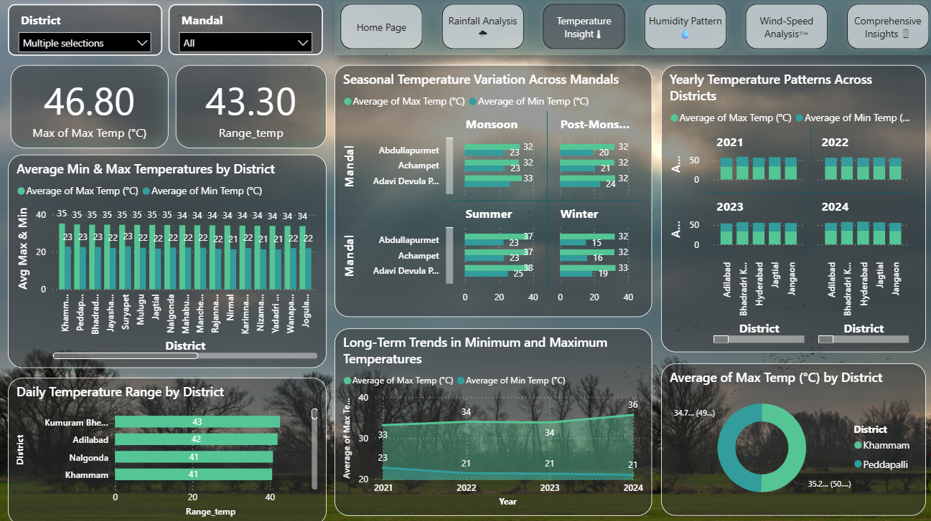

Slide 18
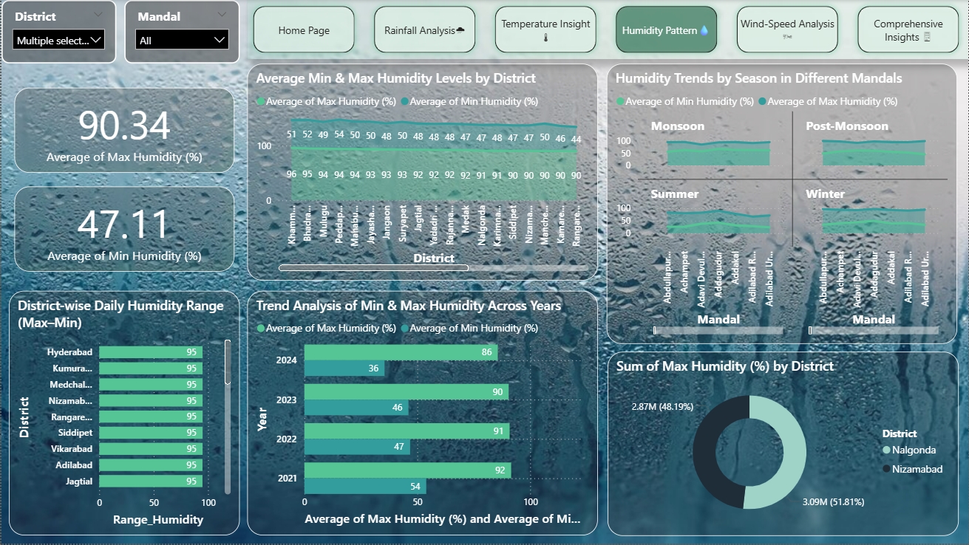

Slide 19
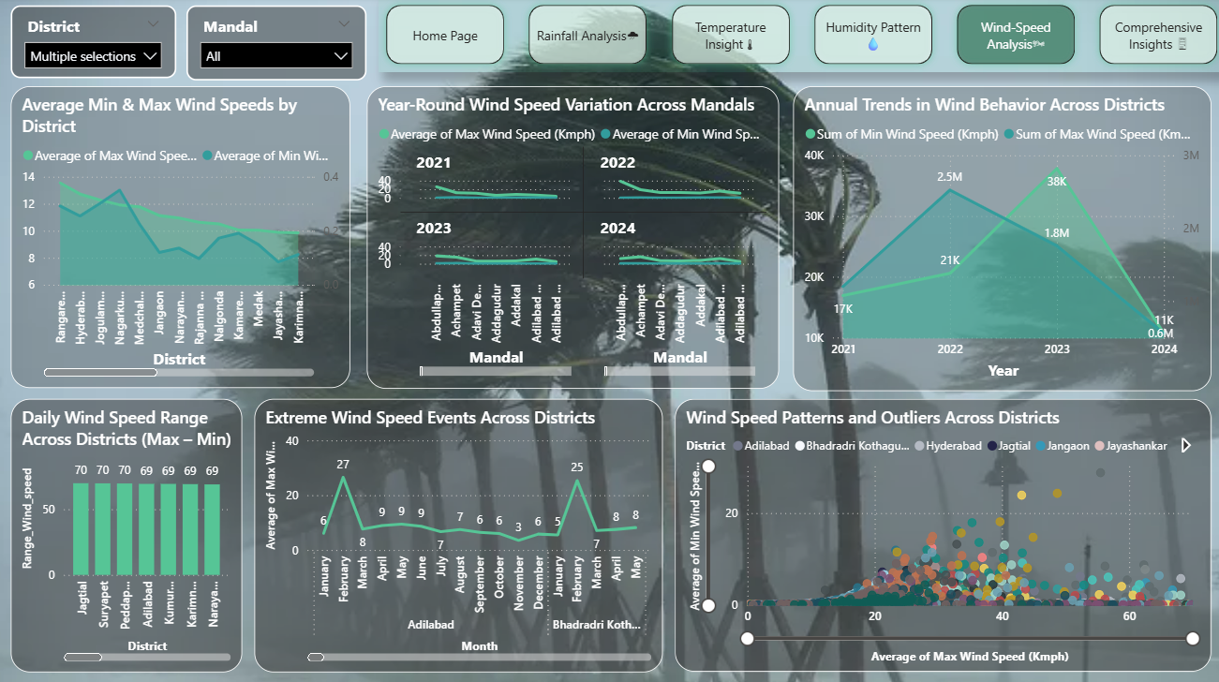

Slide 20
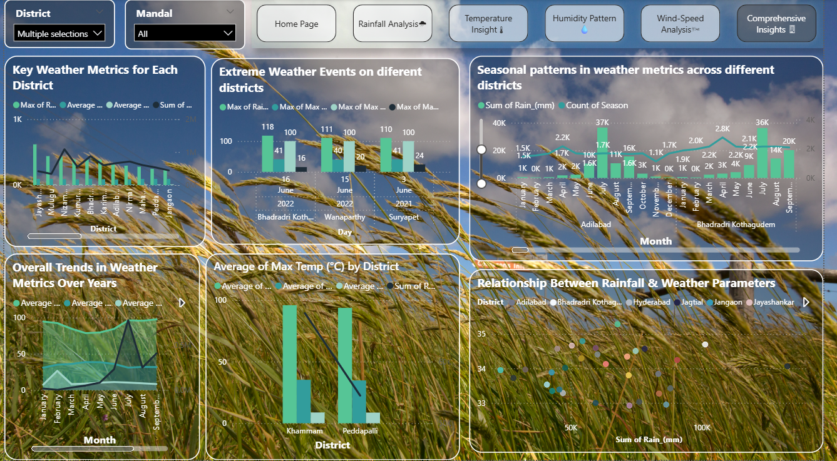

Slide 21
6. Conclusion
Rainfall: Seasonal concentration (70% during monsoon months).
Temperature: Rising yearly trend → possible climate change indicator.
Humidity: Strongly linked with rainfall.
Wind Speed: Extreme events in coastal districts.
Comparative Analysis: District X is better but cooler than District Y.
Overall: Clear evidence of seasonality + anomalies + long-term trends.

Slide 22


Slide 23

THANK YOU

